Slide 1

SQL CASE STUDY
Danny’s Diner
#8weekSQLChallenge
-------------------------------------------------------------------------------------------------------------------------------------------------------------- Krishna Sameera Kota

Slide 2
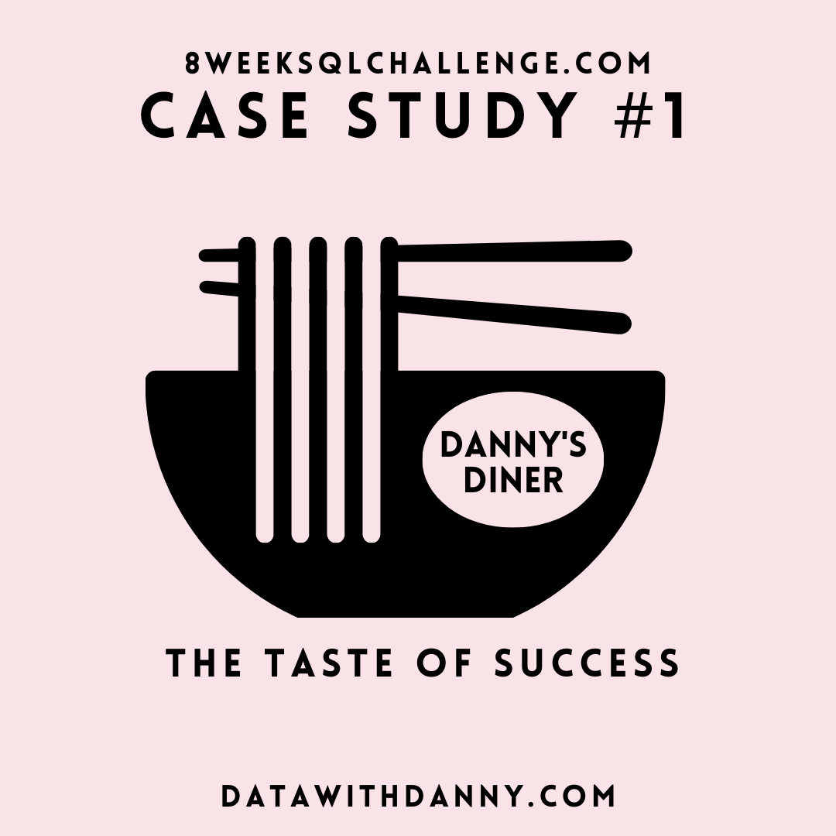
INTRODUCTION:
Danny seriously loves Japanese food so in the beginning of 2021, he decides to embark upon a risky venture and opens up a cute little restaurant that sells his 3 favorite foods: sushi, curry and ramen.
Danny’s Diner is in need of your assistance to help the restaurant stay afloat - the restaurant has captured some very basic data from their few months of operation but have no idea how to use their data to help them run the business.
--------------------------------------------------------------------------------------------------------------------------------------------------------------- Krishna Sameera Kota

Slide 3
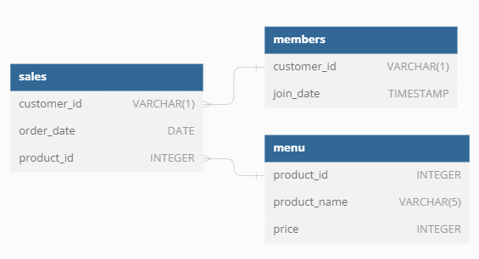
DATA MODEL
--------------------------------------------------------------------------------------------------------------------------------------------------------------- Krishna Sameera Kota

Slide 4
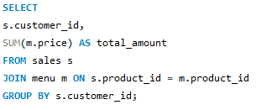

1. What is the total amount each customer spent at the restaurant?
--------------------------------------------------------------------------------------------------------------------------------------------------------------- Krishna Sameera Kota

Slide 5
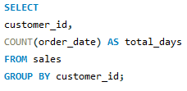

2. How many days has each customer visited the restaurant?
--------------------------------------------------------------------------------------------------------------------------------------------------------------- Krishna Sameera Kota

Slide 6
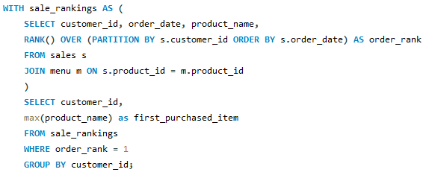

3. What was the first item from the menu purchased by each customer?
--------------------------------------------------------------------------------------------------------------------------------------------------------------- Krishna Sameera Kota

Slide 7
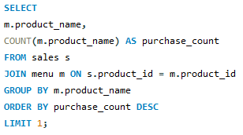

4. What is the most purchased item on the menu and how many times was it purchased by all customers?
--------------------------------------------------------------------------------------------------------------------------------------------------------------- Krishna Sameera Kota

Slide 8
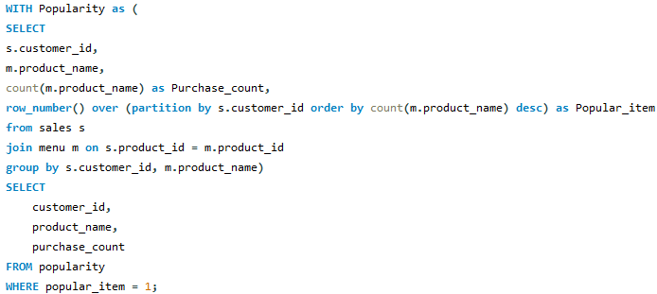

5. Which item was the most popular for each customer?
--------------------------------------------------------------------------------------------------------------------------------------------------------------- Krishna Sameera Kota

Slide 9
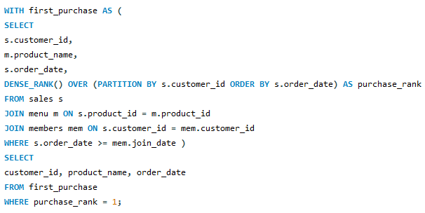
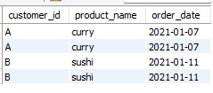
6. Which item was purchased first by the customer after they became a member?
--------------------------------------------------------------------------------------------------------------------------------------------------------------- Krishna Sameera Kota

Slide 10
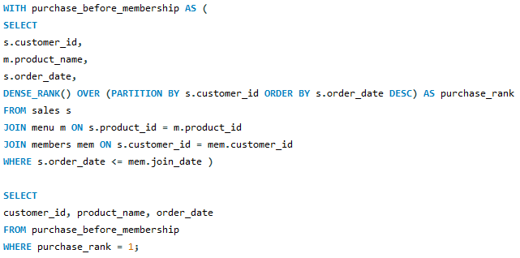
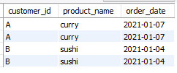
7. Which item was purchased just before the customer became a member?
--------------------------------------------------------------------------------------------------------------------------------------------------------------- Krishna Sameera Kota

Slide 11
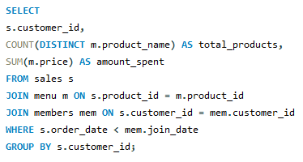

8. What is the total items and amount spent for each member before they became a member?
--------------------------------------------------------------------------------------------------------------------------------------------------------------- Krishna Sameera Kota

Slide 12
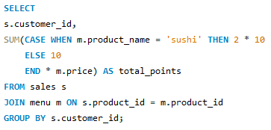

9. If each $1 spent equates to 10 points and sushi has a 2x points multiplier - how many points would each customer have?
--------------------------------------------------------------------------------------------------------------------------------------------------------------- Krishna Sameera Kota

Slide 13
Thankyou
--------------------------------------------------------------------------------------------------------------------------------------------------------------- Krishna Sameera Kota

